Slide 1
Threads in Windows

Slide 2
Name: M.Ahmed Arshed
Section :A

Slide 3
A thread library provides the programmer with an API for creating and managing threads. There are two primary ways of implementing a thread library. The first approach is to provide a library entirely in user space with no kernel support. All code and data structures for the library exist in user space. This means that invoking a function in the library results in a local function call in user space and not a system call.

Slide 4
The second approach is to implement a kernel-level library supported directly by the operating system. In this case, code and data structures for the library exist in kernel space. Invoking a function in the API for the library typically results in a system call to the kernel.

Slide 5
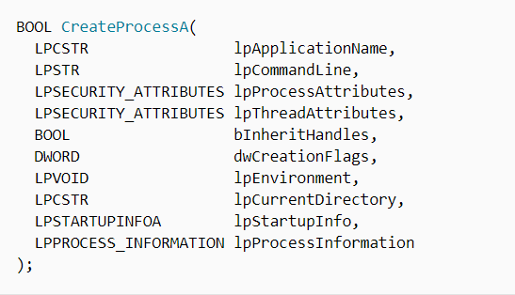
Process Creation

Slide 6
The lpApplicationName parameter can be NULL. In that case, the module name must be the first white space–delimited
The maximum length of this string is 32,768 characters, including the Unicode terminating null character. If lpApplicationName is NULL, the module name portion of lpCommandLine is limited to MAX_PATH characters.
lpThreadAttributes is a pointer to a SECURITY_ATTRIBUTES structure that determines whether the returned handle to the new thread object can be inherited by child processes. If lpThreadAttributes is NULL, the handle cannot be inherited.

Slide 7
If bInheritHandles is TRUE, each inheritable handle in the calling process is inherited by the new process. If the parameter is FALSE, the handles are not inherited
dwCreationFlags control the priority class and the creation of the process.
lpEnvironment is a pointer to the environment block for the new process. If this parameter is NULL, the new process uses the environment of the calling process. An environment block consists of a null-terminated block of null-terminated strings. Each string is in the following form: name=value\0

Slide 8
lpCurrentDirectory is a full path to the current directory for the process. If this parameter is NULL, the new process will have the same current drive and directory as the calling process.
lpStartupInfo is a pointer to a STARTUPINFO structure. To set extended attributes, use a STARTUPINFOEX structure and specify EXTENDED_STARTUPINFO_PRESENT in the dwCreationFlags parameter.Handles in STARTUPINFO or STARTUPINFOEX must be closed with CloseHandle when they are no longer needed.
lpProcessInformation is a pointer to a PROCESS_INFORMATION structure that receives identification information about the new process.Handles in PROCESS_INFORMATION must be closed with CloseHandle when they are no longer needed.

